Slide 1
Hotel Booking Predict
-119cs0032

Slide 2
ProblemStatement
Based on the previous booking data predict the chances for booking cancellation

Slide 3
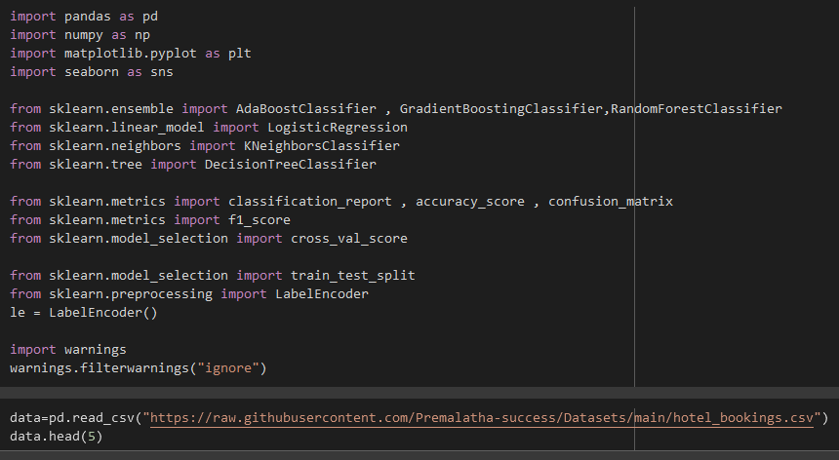
Import ‘lib’ & load ‘dataset’

Slide 4
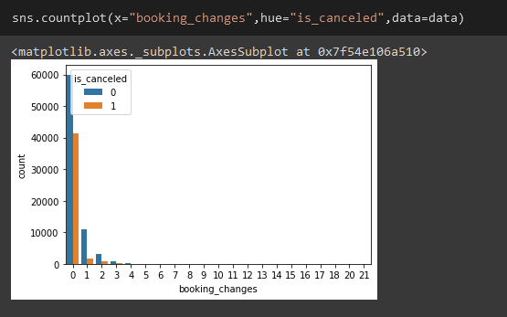
Booking changes (vs) is cancel

Slide 5
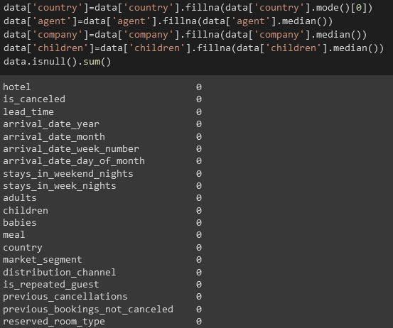
Handling missing data

Slide 6
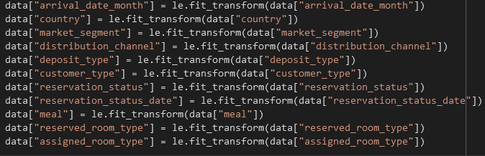
Encoding:object-(0,1)

Slide 7
Building model
#Dividing data into Input X variables and Target Y variable
X = data.drop(["hotel","is_canceled"],axis=1)
y = data["is_canceled"]
X_train,X_test,y_train,y_test=train_test_split(X,y,test_size=0.3,random_state=0)

Slide 8
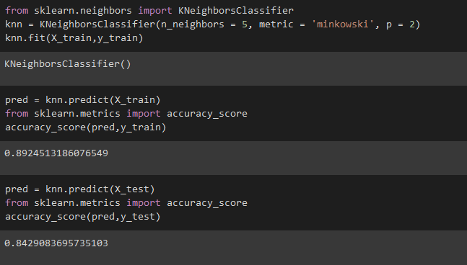
KNN Regression

Slide 9
Conclusion
I am going to use KNN Regression since it gave me the highest score than any other regression that I perform.

